Slide 1
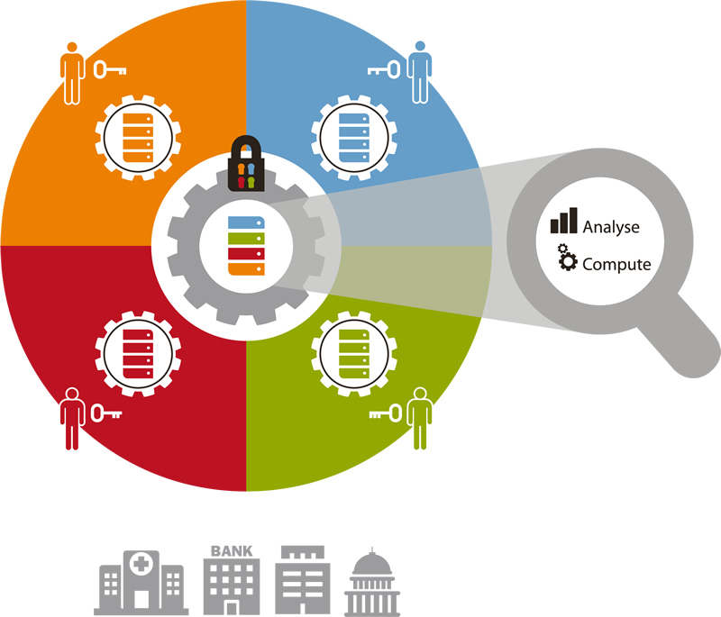
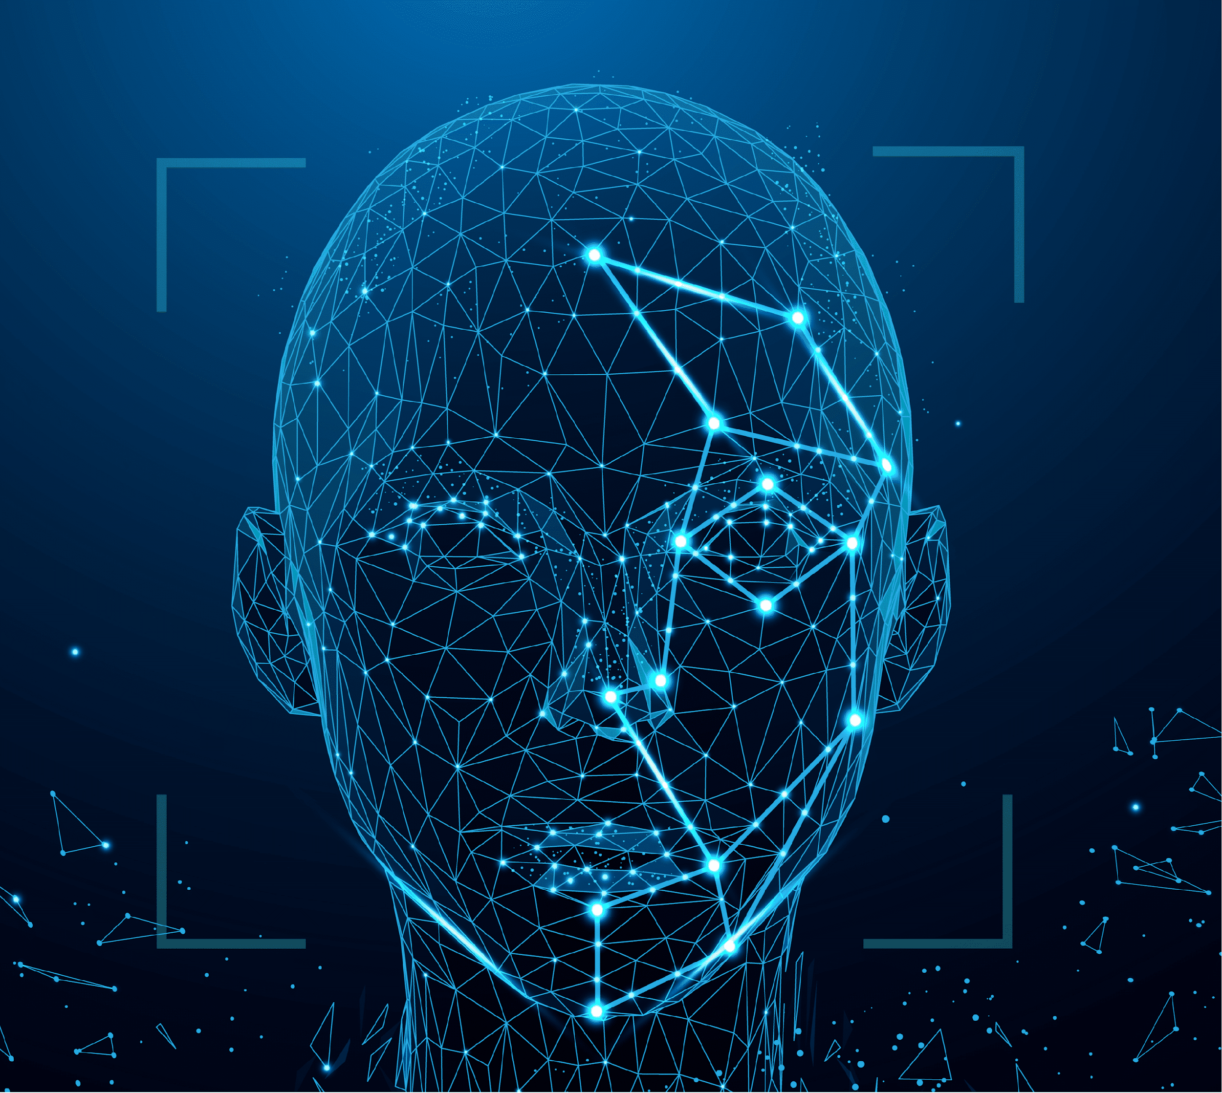
PRIVACY-PRESERVING FACE RECOGNITION
Jahnavi Marthala
Kiran Bala Devineni
Shereen Punnassery
Venkat Mannam
Team-14

Slide 2
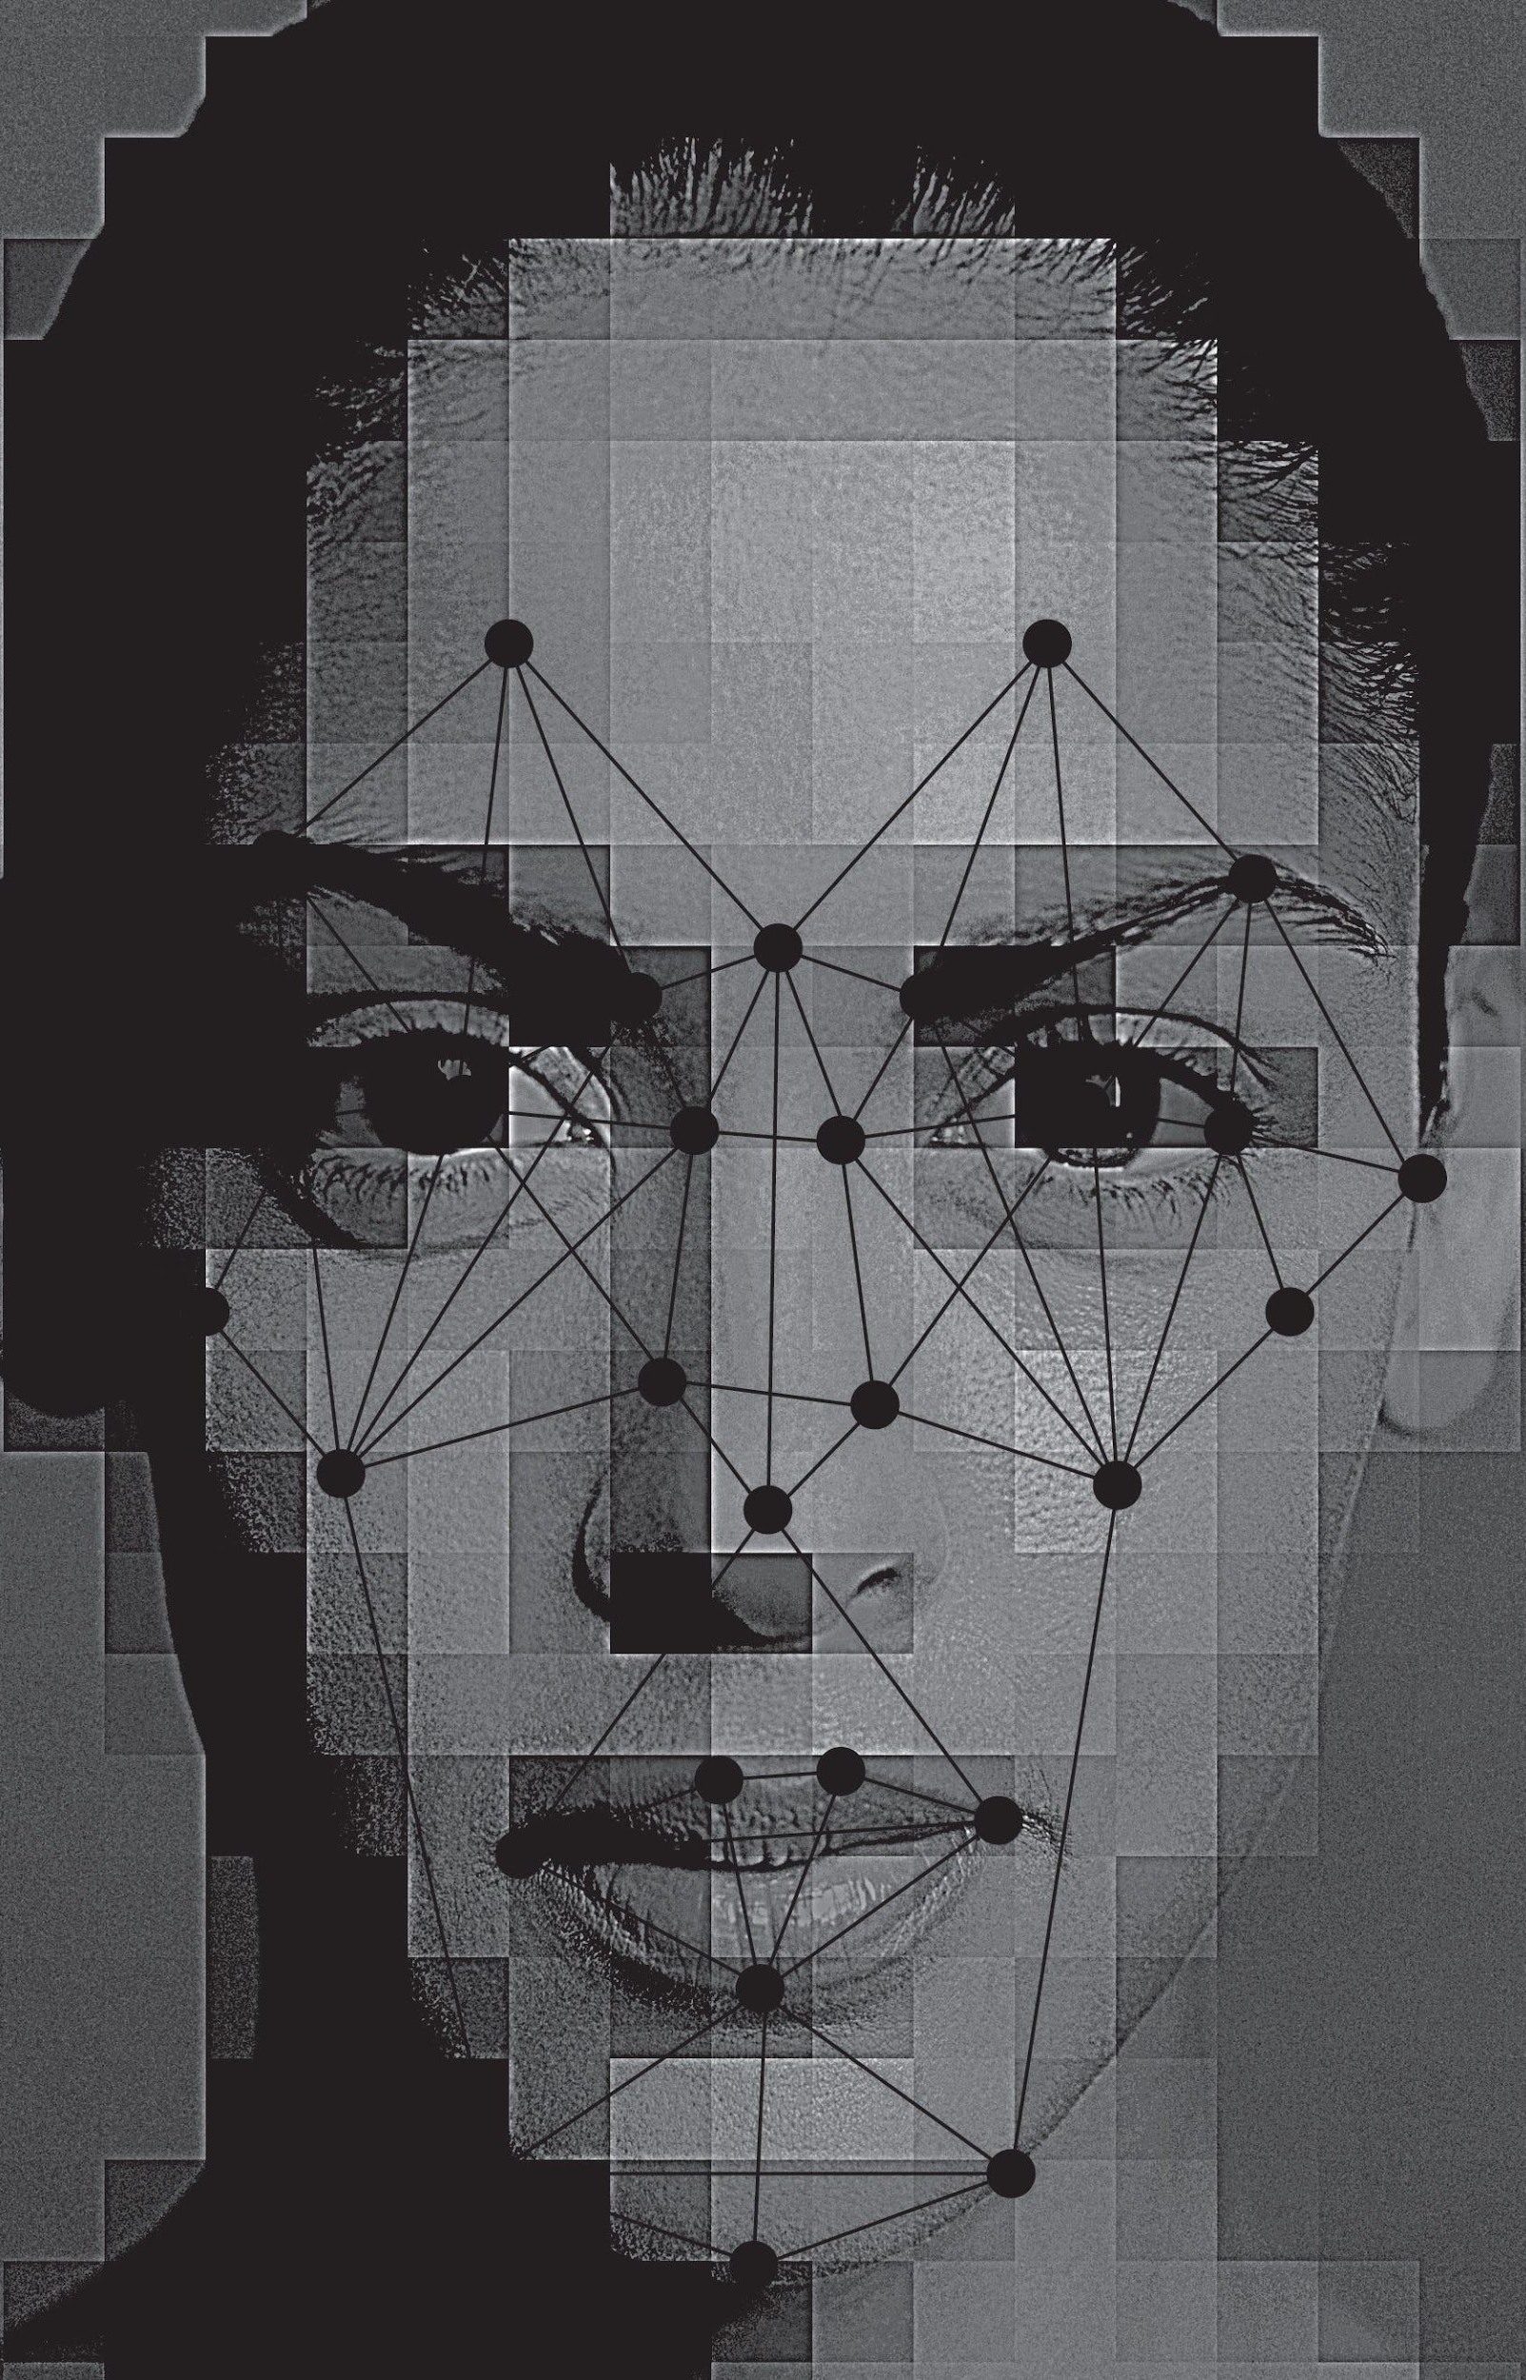
INTRODUCTION
INTRODUCTION
Face recognition is a form of biometric recognition technology that uses a person's facial features to identify them.
Significant privacy concerns have emerged as a result of the widespread use of biometrics.
Face data is usually unique and irreplaceable, once leaked, it will cause great damage to the user's privacy.
A face recognition privacy protection model based on Secure Multi-Party Computation (sMPC) is proposed.
Face recognition is performed by calculating sensitive data from multiple sources, while maintaining the privacy of face data.
Face recognition is a form of biometric recognition technology that uses a person's facial features to identify them.
Significant privacy concerns have emerged as a result of the widespread use of biometrics.
Face data is usually unique and irreplaceable, once leaked, it will cause great damage to the user's privacy.
A face recognition privacy protection model based on Secure Multi-Party Computation (sMPC) is proposed.
Face recognition is performed by calculating sensitive data from multiple sources, while maintaining the privacy of face data.

Slide 3
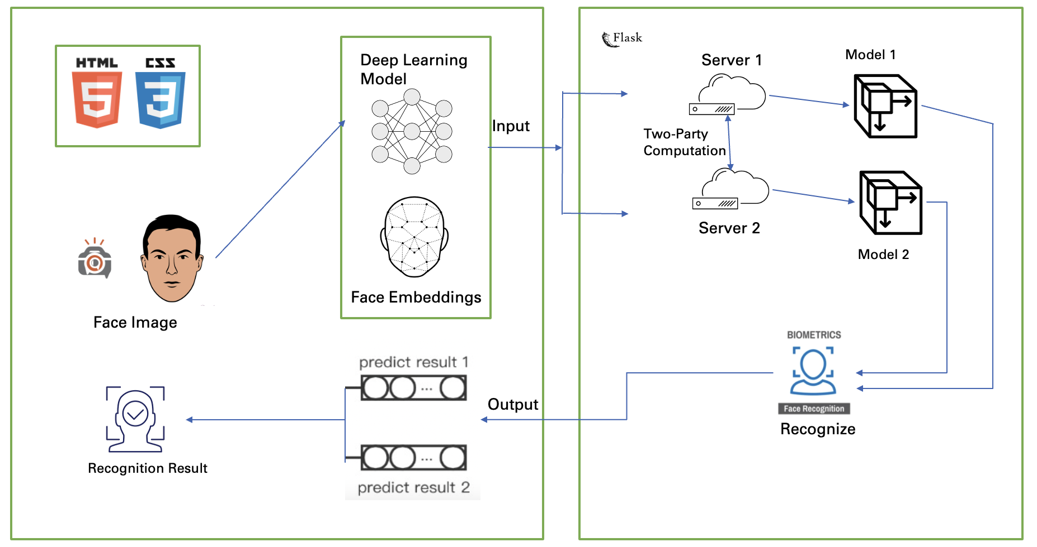
ARCHITECTURE DIAGRAM

Slide 4

TECHNOLOGY STACK
TECHNOLOGY STACK
Front-End : HTML, CSS
Backend: Python, Flask (Web Framework)
Machine Learning Model : Keras encrypted model
Libraries : OpenCV, dlib, Tensorflow, Keras, Scikit-Learn, Pandas, Numpy, imutils, Matplotlib, OpenFace, MPC
Front-End: HTML, CSS
Backend: Python, Flask (Web Framework)
Machine Learning Model: Convolutional Neural Networks
Libraries: OpenCV, dlib, Tensorflow, Keras, Scikit-Learn, Pandas, Numpy, imutils, Matplotlib, OpenFace, MPC
Platforms: AWS

Slide 5
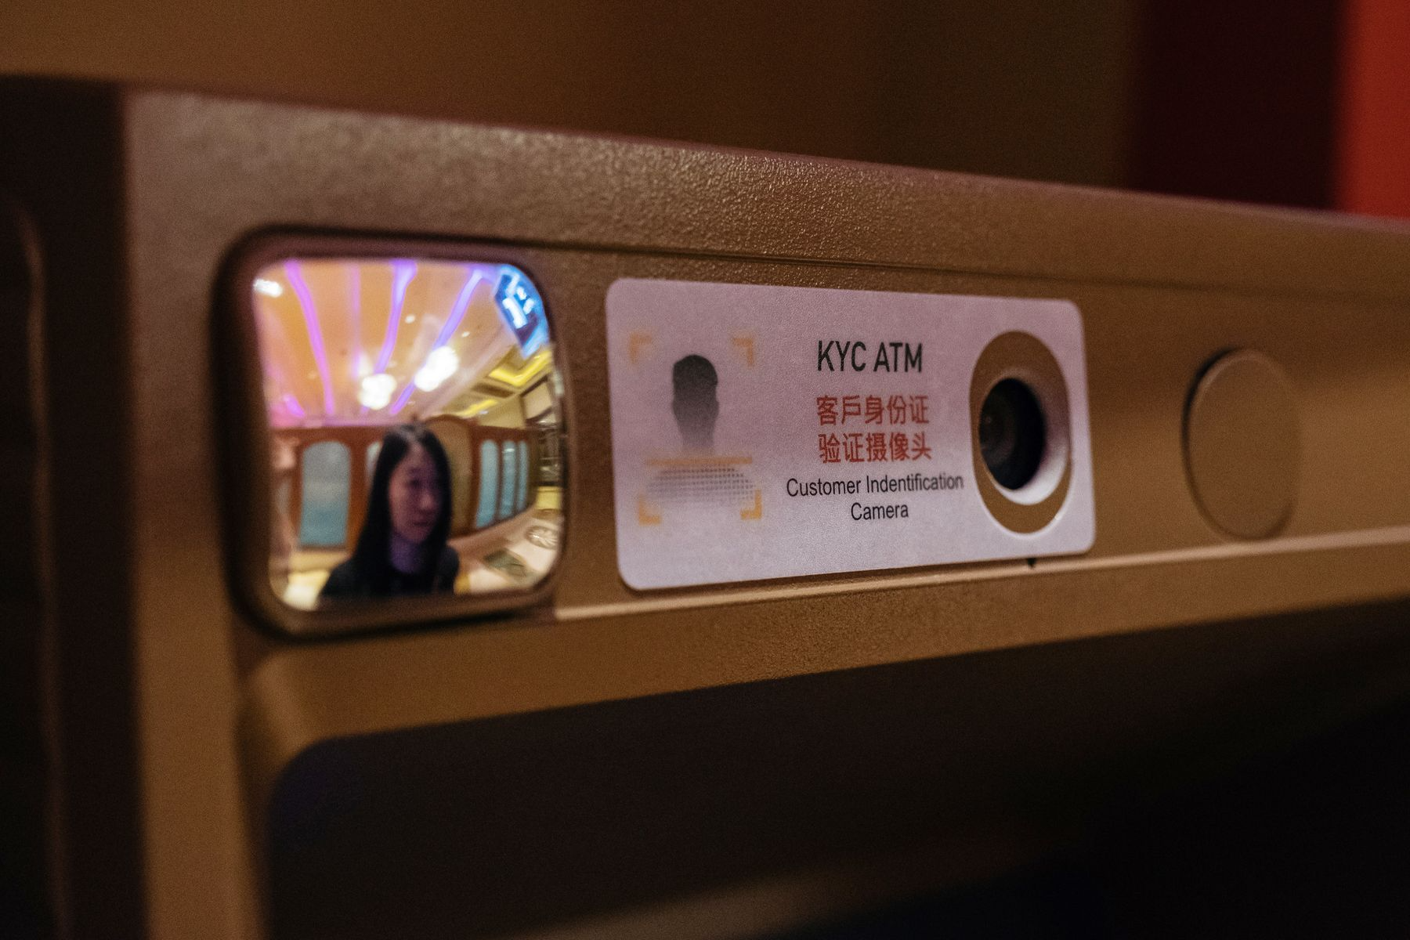
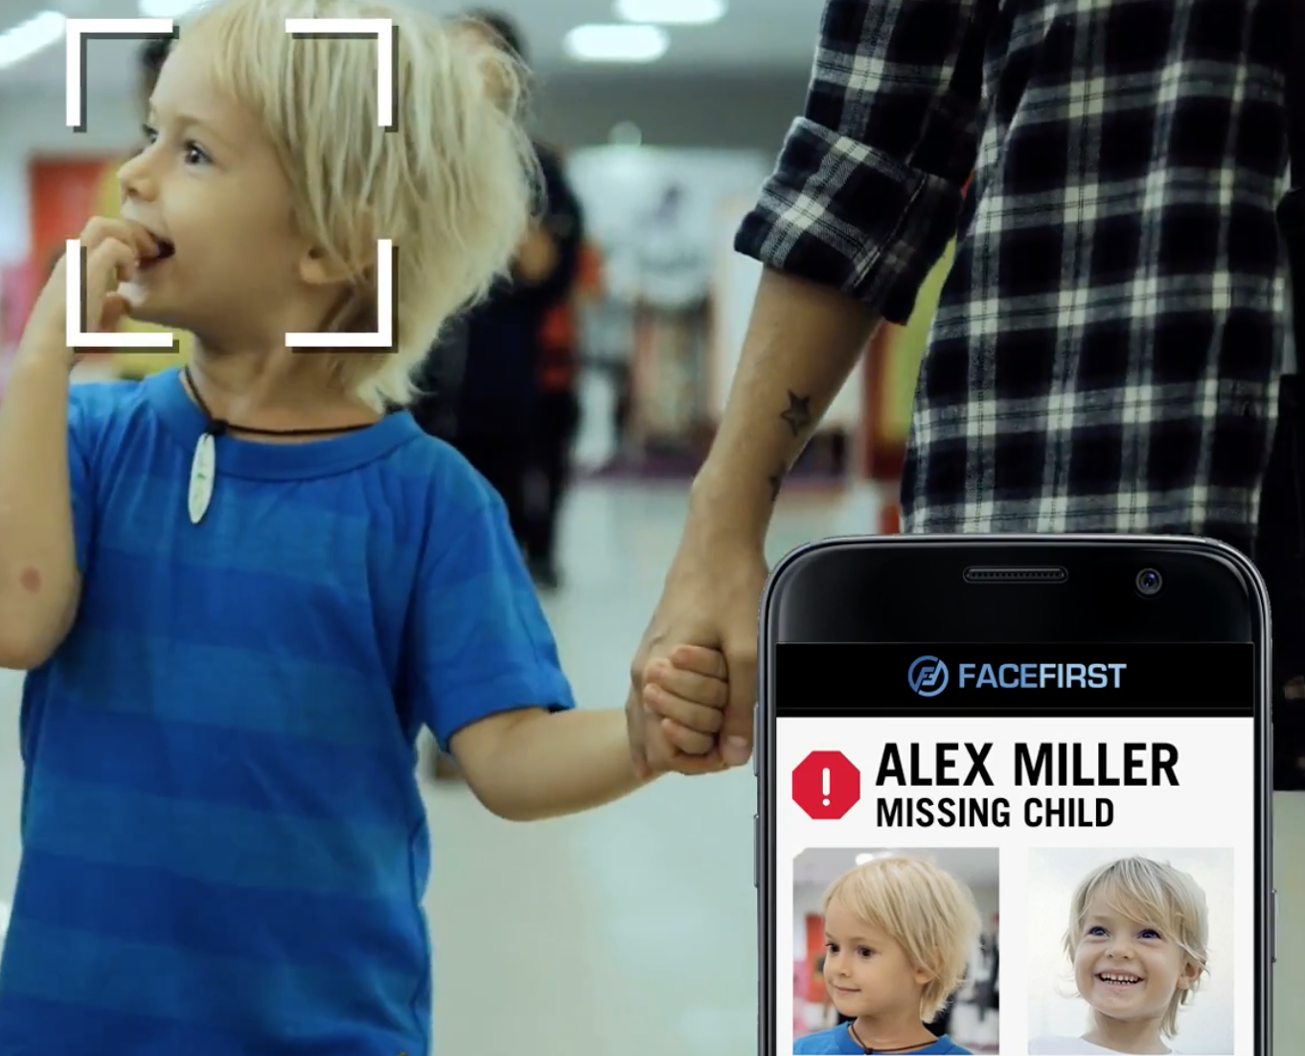
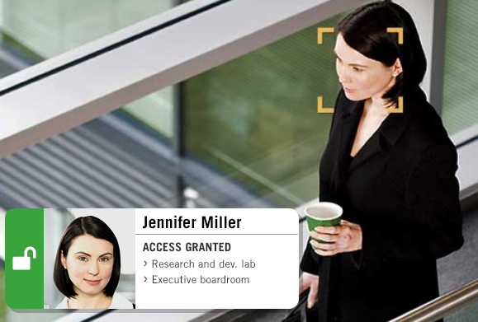
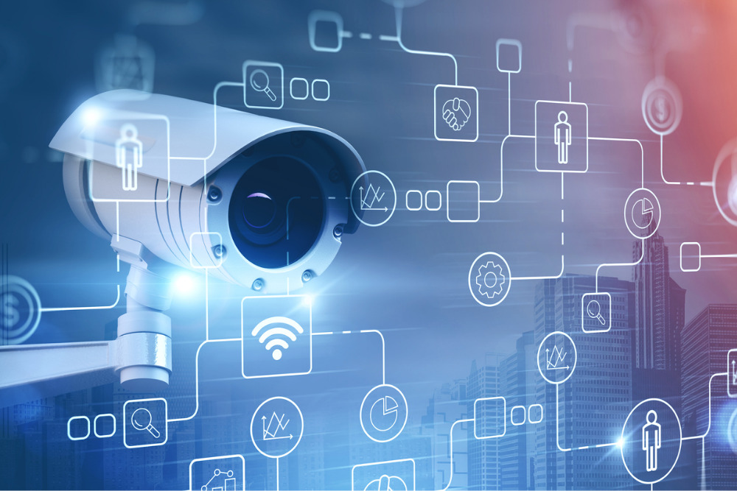
PERSONA
Validate Identity at ATMs ATMs
Find Missing Persons
Face scans will eventually replace ATM cards completely. Face recognition can be used to make sure that individuals using ATMs cards are who they say they are and prevent fraudulence of chip cards.
Face recognition can be used to find missing children and victims of human trafficking. As long as missing individuals are added to a database, law enforcement can become alerted as soon as they are recognized by face recognition.
Control Access to Sensitive Areas
surveillance system
Works as a means of access control to ensure that only authorized individuals get into facilities like labs, boardrooms and other sensitive locations.
Aids forensic investigations by automatically recognizing individuals in security footage or other videos. Also, used to identify dead or unconscious individuals at crime scenes.

Slide 6
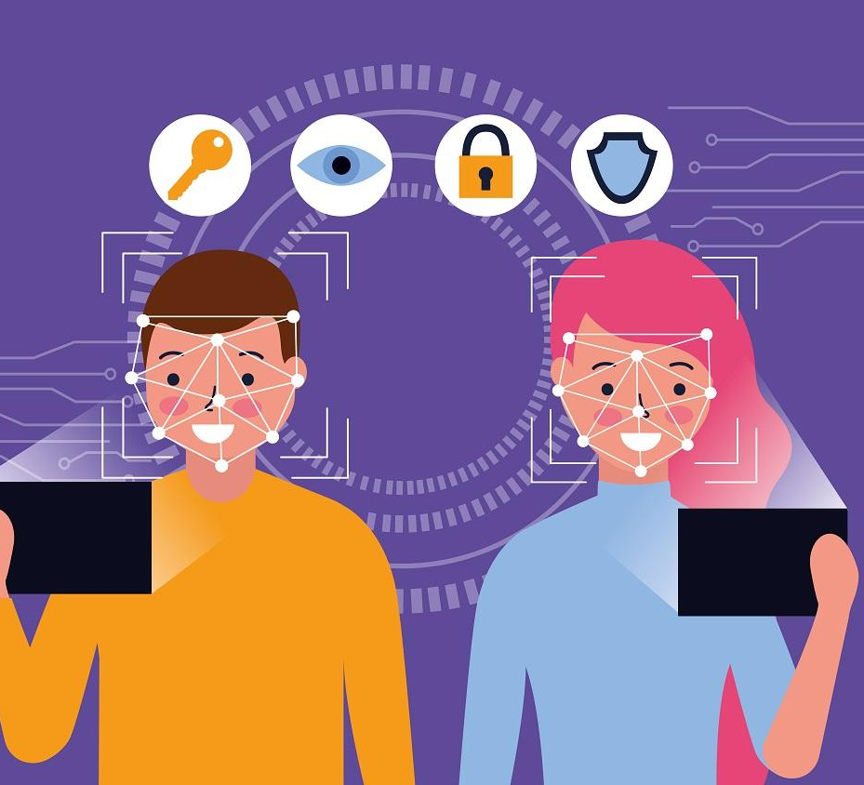
FUTURE SCOPE
FUTURE ENHANCEMENTS
Creation of app as a service
Integration of database to store images for training and recognition.
Creation of app as a service
Integration of database to store images for training and recognition.

Slide 7

DEMO
DEMO

